Slide 1
*AAT Clicker Review
Ch. 11

Slide 2
Please select a Team.
Team 1
Team 2
Team 3
Team 4
Team 5
10

Slide 3
1. Identify the conic. $\frac{y^{2}}{36}−\frac{x^{2}}{25}=1$
parabola
ellipse
hyperbola
circle
10

Slide 4
Team Scores
Points | Team | Points | Team

Slide 5
2. Identify the conic. $\frac{x^{2}}{225}+\frac{y^{2}}{112}=1$
parabola
ellipse
hyperbola
circle
10

Slide 6
Team MVP
Points | Team | Participant

Slide 7
3. Identify the conic. $\frac{x^{2}}{25}+\frac{y^{2}}{25}=1$
parabola
ellipse
hyperbola
circle
10

Slide 8
4. Identify the conic. y= ${8x}^{2}+32x+33$
parabola
ellipse
hyperbola
circle
10

Slide 9
Participant Scores
Points | Participant | Points | Participant

Slide 10
5. Find the vertex. $x={2y}^{2}+8y+3$
V(-2, -5)
V(5,-2)
V(-5,-2)
V(2,-5)
10

Slide 11
Fastest Responders (in seconds)
Seconds | Participant | Seconds | Participant

Slide 12
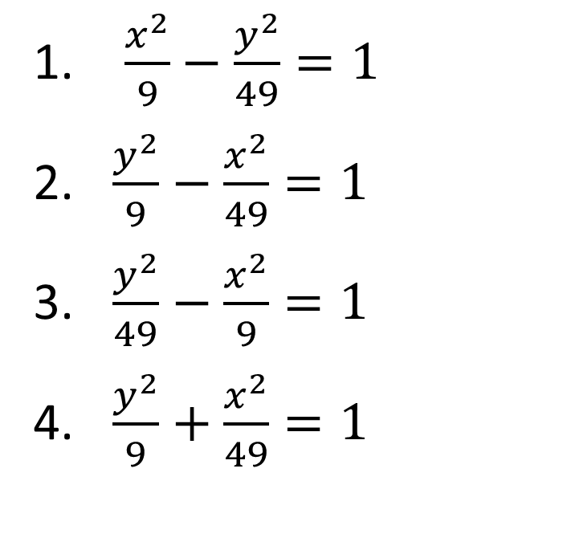
6. Find an equation for the conic that satisfies hyperbola with vertices V(0, $±7),$& endpoints of conjugate axis ($±3,0).$
$\frac{x^{2}}{9}−\frac{y^{2}}{49}=1$
$\frac{y^{2}}{9}−\frac{x^{2}}{49}=1$
$\frac{y^{2}}{49}−\frac{x^{2}}{9}=1$
$\frac{y^{2}}{9}+\frac{x^{2}}{49}=1$
10

Slide 13
Team Scores
Points | Team | Points | Team

Slide 14

7. Find an equation for the conic that satisfies parabola with focus F(-4,0) and directrix x=4.
y=-16$x^{2}$
x=-16$y^{2}$
3. $y^{2}=−16x$
10

Slide 15
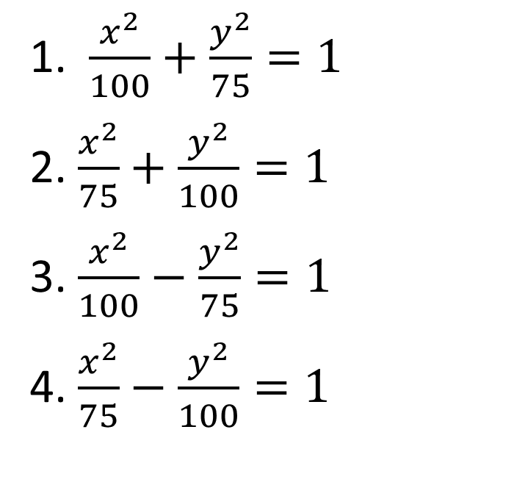
8. Find an equation for the conic that satisfies ellipse with vertices V(0, $±10)$and foci F(0, $±5).$
1. $\frac{x^{2}}{100}+\frac{y^{2}}{75}=1$
2. $\frac{x^{2}}{75}+\frac{y^{2}}{100}=1$
3. $\frac{x^{2}}{100}−\frac{y^{2}}{75}=1$
4. $\frac{x^{2}}{75}−\frac{y^{2}}{100}=1$
10

Slide 16
Team MVP
Points | Team | Participant

Slide 17
9. What is the center and the radius of the circle. $(x−3)^{2}+(y+4)^{2}=36$
C(-3, 4); r = 12
C(3, -4); r = 12
C(3, -4); r = 6
C(-3, -4); r = 6
10

Slide 18
Participant Scores
Points | Participant | Points | Participant

Slide 19
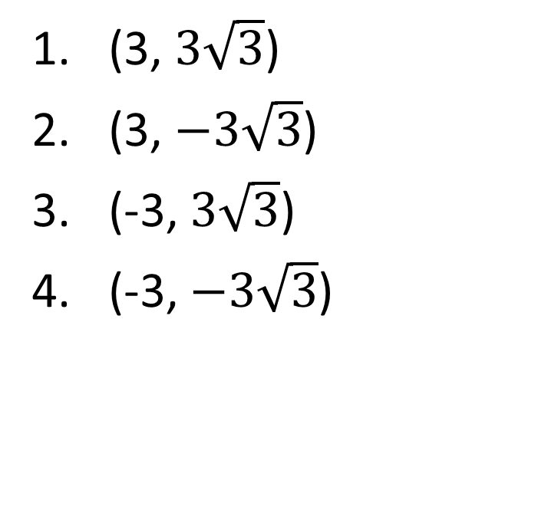
10. Change the polar coordinates to rectangular coordinates. (-6, $\frac{7π}{3})$
(3, $3\sqrt{3}$)
(3, $−3\sqrt{3}$)
(-3, $3\sqrt{3}$)
(-3, $−3\sqrt{3}$)
10

Slide 20
Team Scores
Points | Team | Points | Team

Slide 21
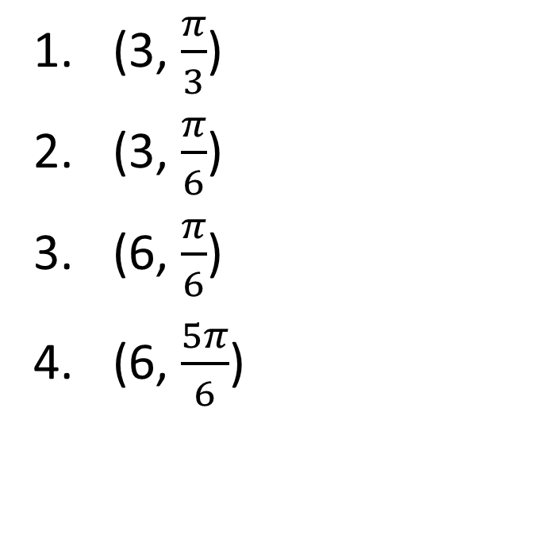
11. Change the rectangular coordinates to polar coordinates with r $>0 and 0≤θ≤2π.$ (3$\sqrt{3}$, 3)
(3, $\frac{π}{3}$)
(3, $\frac{π}{6}$)
(6, $\frac{π}{6}$)
(6, $\frac{5π}{6}$)
10

Slide 22
Team MVP
Points | Team | Participant

Slide 23

Find a polar equation that has the same graph as the equation in x and y. y = 2
r = 2 sin $θ$
r = 2 sec $θ$
r = 2 csc $θ$
r = 2 cot $θ$
10

Slide 24
Fastest Responders (in seconds)
Seconds | Participant | Seconds | Participant

Slide 25
Team Scores
Points | Team | Points | Team

