Slide 1
*AAT Clicker Review
Ch. 10

Slide 2
Please select a Team.
Team 1
Team 2
Team 3
Team 4
Team 5
10

Slide 3
1. Find the fourth term of the sequence. {4+(0.1$)^{n}\}$
4.001
4.0001
4.00001
4.000001
10

Slide 4
Team Scores
Points | Team | Points | Team

Slide 5
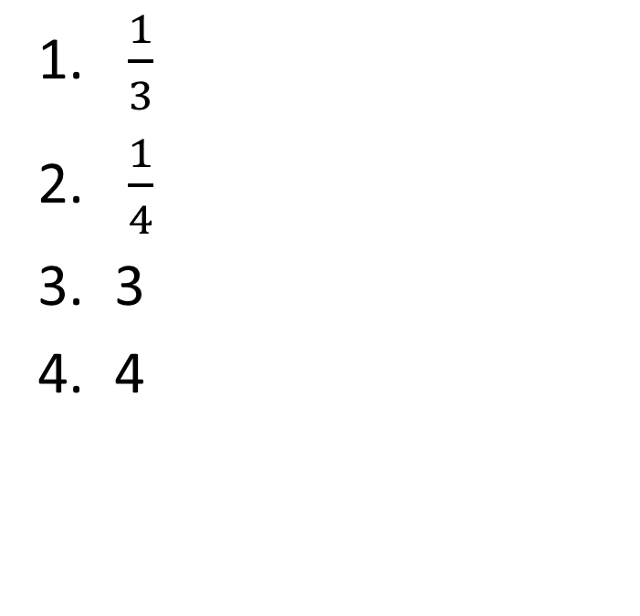
2. Find the fifth term of the recursively defined infinite sequence. $a_{1}=3; a_{k+1}=\frac{1}{a_{k}}$
$\frac{1}{3}$
$\frac{1}{4}$
3
4
10

Slide 6
Team MVP
Points | Team | Participant

Slide 7
3. Find the sum. $\sum_{k=0}^{4}{3(2^{k})}$
90
91
92
93
10

Slide 8
4. Find the tenth term of the arithmetic sequence. x-8, x-3, x+2, x+7, …
x+10
x+15
x+37
x+42
x+47
10

Slide 9
Participant Scores
Points | Participant | Points | Participant

Slide 10
5. Find the specified term of the arithmetic sequence. $a_{10}; a_{2}=1, a_{18}=49$
25
17
31
23
10

Slide 11
Fastest Responders (in seconds)
Seconds | Participant | Seconds | Participant

Slide 12
6. Find the sum of the arithmetic sequence. $$a_{1}=5, d=0.1, n=40$$
300
275
278
305
10

Slide 13
Team Scores
Points | Team | Points | Team

Slide 14
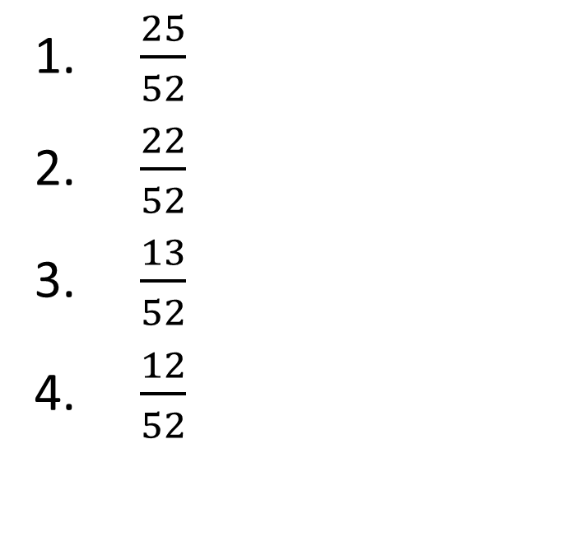
7. One card is selected from a standard deck of cards. What is the probability that the card is either a heart or a face card?
$\frac{25}{52}$
$\frac{22}{52}$
$\frac{13}{52}$
$\frac{12}{52}$
10

Slide 15
8. Find the fifth term of the geometric sequence. $1, −\sqrt{3}, 3, −3\sqrt{3},…$
3
-3
9
-9
10

Slide 16
Team MVP
Points | Team | Participant

Slide 17

9. A random number generator on a computer selects three integers from 1 to 20. What is the probability that all three numbers are less than or equal to 5?
$\frac{1}{4}$
$\frac{1}{16}$
$\frac{1}{64}$
$\frac{1}{256}$
10

Slide 18
Participant Scores
Points | Participant | Points | Participant

Slide 19

10. Find the geometric mean of 4 and 8.
6
7.5
6$\sqrt{2}$
4$\sqrt{2}$
10

Slide 20
Team Scores
Points | Team | Points | Team

Slide 21
11. Find P(4,4).
4
1
16
24
10

Slide 22
Team MVP
Points | Team | Participant

Slide 23
12. Find P(n,1).
1
n
0
n-1
10

Slide 24
Fastest Responders (in seconds)
Seconds | Participant | Seconds | Participant

Slide 25
13. Two dice are tossed, one after the other. List the number of different ways the sum of the dots can equal 9.
3
4
5
6

Slide 26

14. An ice cream parlor stocks 31 different flavors and advertises that it serves almost 4500 different triple scoop cones, with each scoop being a different flavor. How was this number obtained?
P(31,3)
C(31,3)
31!
4. $\frac{P(31,3)}{31}$
10

Slide 27

15. Three dice are tossed. Find the probability that all dice show the same number of dots.
1. $\frac{6}{18}$
2. $\frac{6}{36}$
3. $\frac{6}{216}$
4. $\frac{5}{9}$
10

Slide 28
Team Scores
Points | Team | Points | Team

